Slide 1
Capstone Project
Recommending Locations for starting a Indian Restaurant
in
Manhattan , New York
By Avinash

Slide 2
Introduction: Business Problem
In this project we will try to find an optimal location for a restaurant.
Specifically, this report will be targeted to stakeholders interested in opening an Indian restaurant in Manhattan,New York.
Since there are lots of restaurants in New York we will try to detect locations that are not already crowded with restaurants.
We are also particularly interested in areas with no Indian restaurants.

Slide 3
Data
Data Required
List of Neighbourhood in New York
geographical coordinates of Neighbourhoods
List of Restaurants in Neighbourhoods
Data sources needed to extract/generate the required information:
Json file https://cocl.us/new_york_dataset contains Neighbourhoods of New York.
Geocoder for getting Latitude and Longitude of Neighbourhoods.
FourSquare API is needed for Venues.

Slide 4
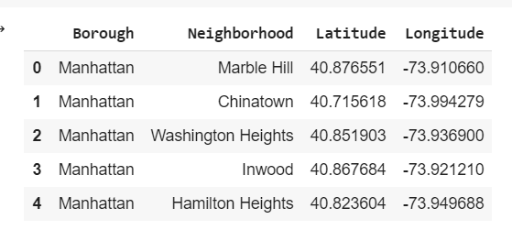
Methodology
Extracting Neighbourhood data from Json file.
Use Geopy library to get the latitude and longitude values of Manhattan , New York .
Now we need to get top venues in each Neighbourhood using Foursquare.

Slide 5
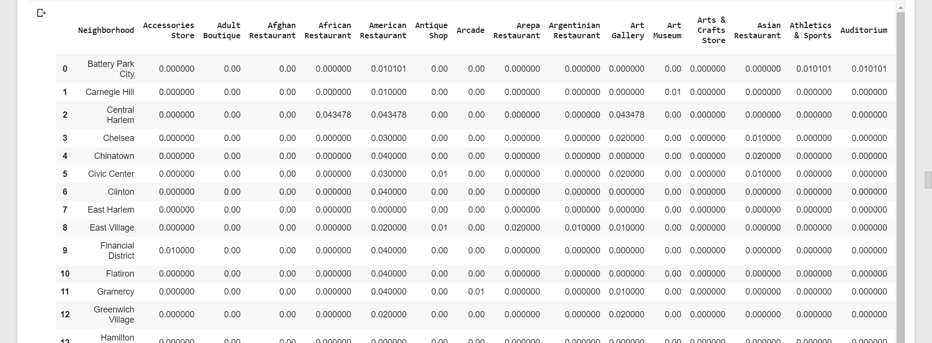
we need to group by Neighbourhood and take mean of the frequency of occurrence of each category
Filter Venues by Indian Restaurants.

Slide 6
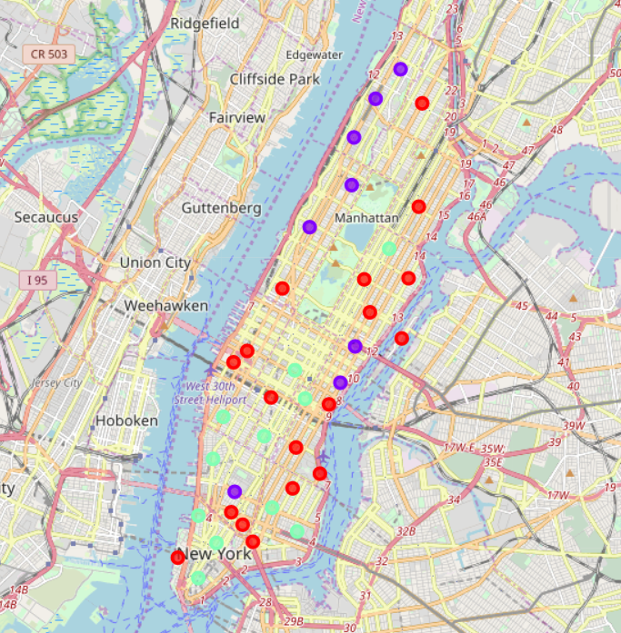
Perform k-means clustering on extracted data.
Visualize clusters using Folium

Slide 7
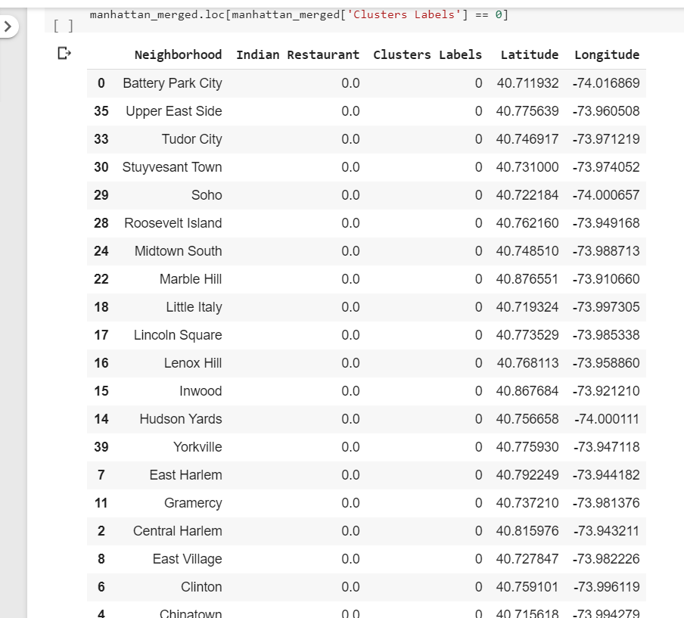
Result
Clustering data into 3 Categories
Cluster 0:Neighbourhoods with no Indian Restaurants.

Slide 8
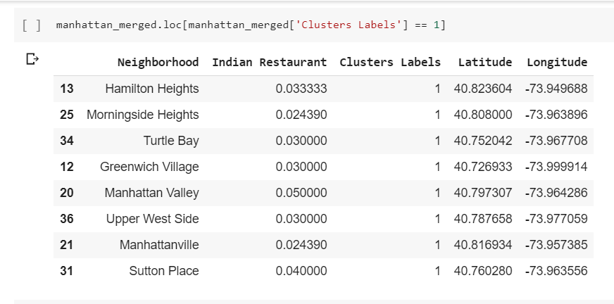
Cluster 1
Cluster 1:Neigbourhoods with High number of Indian Restaurants.

Slide 9
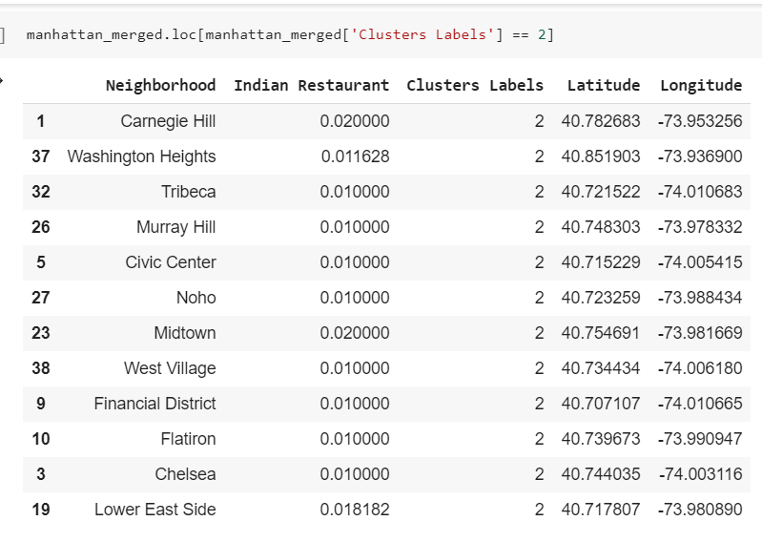
Cluster 2
Cluster 2:Neighbourhood with moderate number of Indian Restaurants.

Slide 10
Discussion
Neighbourhoods in Cluster 0 have no Indian Restaurants
Neighbourhoods in Cluster 1 have high number of Indian Restaurants.
Neighbourhoods in Cluster 2 have moderate number of Indian Restaurants.
We can also observe that Neighbourhoods in east Manhattan does have low to none Indian Restaurants

Slide 11
Conclusion
By analysing clusters we can conclude Neighbourhoods in Cluster 0 are ideal for starting new Indian Restaurant

